Slide 1





KORTEX PSI PRESENTATION
PRODUCTS AND APPLICATIONS
2018 MAY

Slide 2
SUMMARY
Presentation of the company KORTEX
A complete range of cellular routers
A great number of M2M applications
Use case
KORTEX News
Future developments
Essential accessories for 2017

Slide 3


PRESENTATION OF KORTEX COMPANY
Products and services for electronic banking,
M2M, connected object
and energy efficiency
A French company on a human scale.
KORTEX PSI is a subsidiary of LYRA NETWORK since 2010.
1985 - 2018, more than 30 years of experience in the telecom world.
Integrated R&D: Hardware developments, software and embedded applications.
Expertise: Telecoms Point of sales, energy, M2M and connected objects.

Slide 4

Use case
A large number of products and business applications, some examples
Point of sales and CB payments
Industrial and banking machines
Charging terminals for electric vehicles
Energy performance, meter reading
Energy: management of heating and buildings
Solar panels, wind farms
Industries and infrastructures
Oil, fuel distribution
PML / PMV dynamic display
Security / CCTV
Transport network

Slide 5
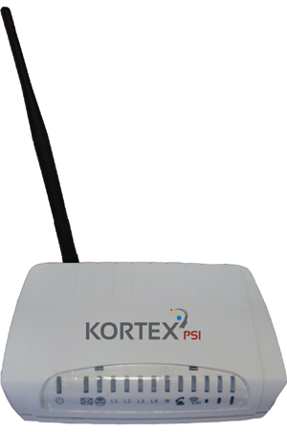






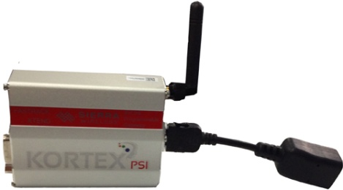

Cellular routers
LM Serie
LM3G
LM4G
Auto-configuration via the LYRA portal
SMS
antennas
optional
LM2G
Optional DIN rail

Slide 6
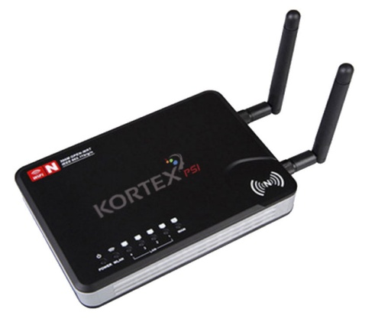


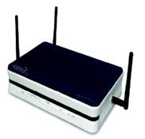


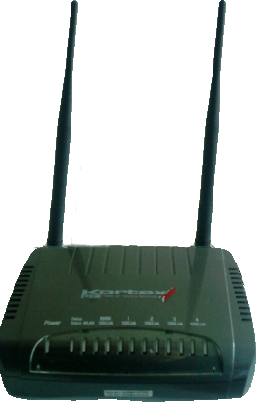

Other CELLULAR ROUTERS
KXPRO WIFI
KXPRO 3G / 4G
KX 3G ADSL2+ ROUTER
KX WM BOX ENERGY 868 MHZ*
* DIN rail optional

Slide 7
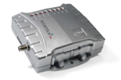

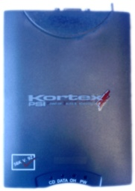
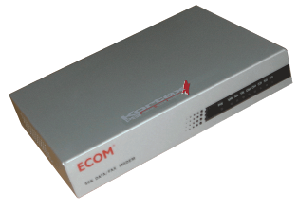
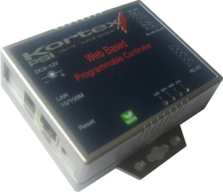

Cellular (GPRS-EDGE) and analog modems
Kx GPRS Commerce Plus 2
Kx GPRS Commerce Pro 2
56K Modems
Kx Serial Web Controller
Kx GPRS Serial Ethernet

Slide 8
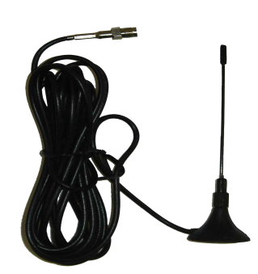

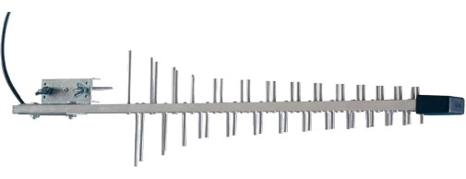


KORTEX antennas and accessories
KORTEX PSI recommends the use of remote antennas in case of poor coverage, poor reception or fluctuations and instability of 3G / 4G networks at the installation site, these antennas can be used to get a better signal.
Ref: CB001332
Ref: CB001331 magnetic
Supplied with mounting bracket
Réf : CB001334 to screws
Ref: CB001330
magnetic
D71x14 mm
D47x210 mm
* For 4G antennas, please consult us

Slide 9





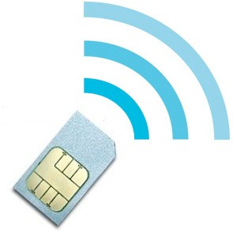




The solution KORTEX / LYRA 2, 3, 4G
The advantages:
  Adapted equipment, configurable from the LYRA portal
  Security (Private APN gprsnac.com or gprsnac.o2.de)
  Billing when activating SIMs
  Creating M2M routes on the portal to an IP address and port
  FTP Proxy, HTTP, SMTP Relay
  WEB 2.0 Portal for SIM management: innovation and performance
  Mutualization of flows by operator: BOUYGUES, SFR, ORANGE, O2

Slide 10
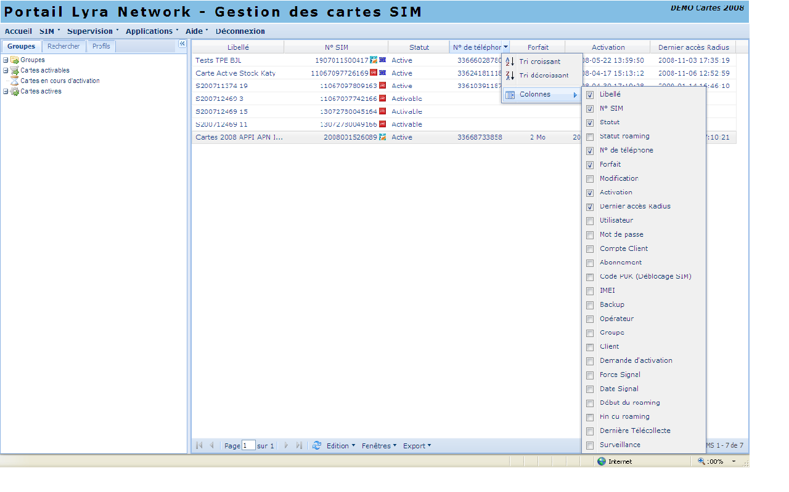

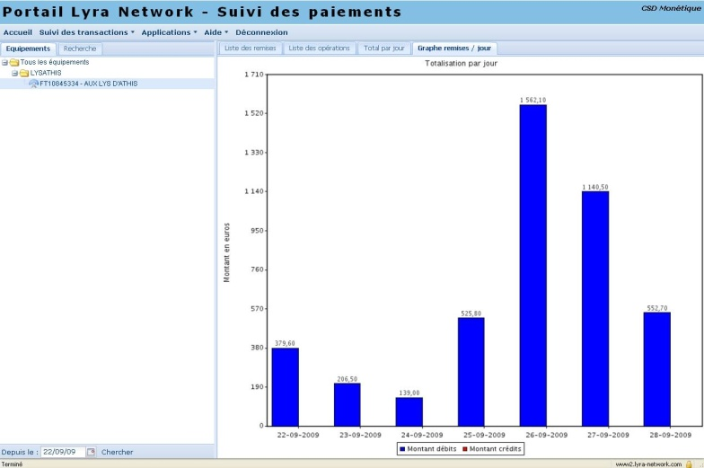





The Lyra Network 2.0 web portal
Gest SIM
Gestion, commande et
activation des cartes
Gest IP
Gestion et enregistrement
des équipements IP
VisuPaiements
Suivi, consolidation et
analyse des transactions
Stat Web
Suivi de la qualité de
service des accès RTC
Back-offices Payzen
Gestion et suivi des
paiements en temps réel

Slide 11







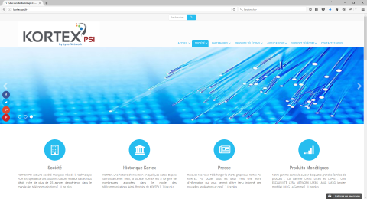

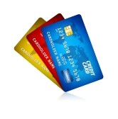

A GREAT NUMBER OF M2M APPLICATIONS
INDUSTRY
PANNEL DISPLAY
ENERGY
TRAFFIC
ELECTRONIC BANKING
SECURITY
To find on www.kortex-psi.fr

Slide 12
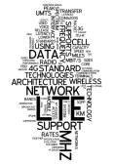


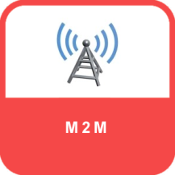



Some KORTEX PSI applications

Slide 13

Products for ...

Slide 14
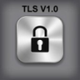



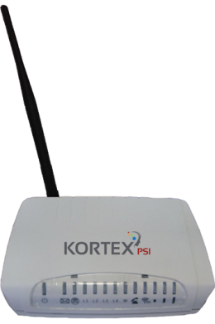












Standalone payment terminals in 4G & RTC Backup
Banking
Servers
VERIFONE
VX 520
LYRA SIM
Public
X25 Network
Network Mobil Operators
X25
ETH
IP
IP/X25 Platform
LL
POS PSTN Fallback
LM4G
APN (Radius Server) gprsnac.com
LL
Banking
Servers
INGENICO
ICT250
Solution Advantages:
  Vitale ™ Cards & EMV CBs
  4 Ethernet ports = 4 TPE (possibility to add a Network Switch)
  GPRS / EDGE bi-networks and 3G / 3G + if necessary
  Speed ​​of transactions: equivalent to ADSL (less than 5 seconds)
  1 single SIM card LYRA = 1 single subscription for several payment terminals
  Secure APN gprsnac.com with management through the portal LYRA
  Security: Encryption with V3 STCA SSL certificate
  QOS Replica RTC on payment terminals (1 shared line)
  WIFI option
Private
Servers

Slide 15

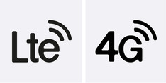

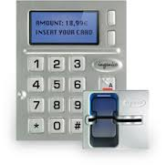

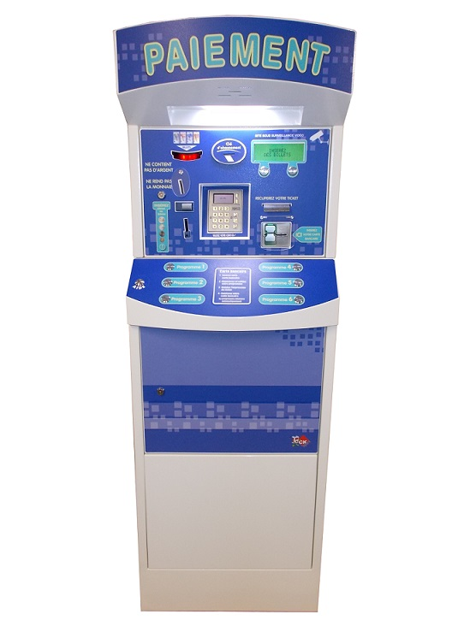
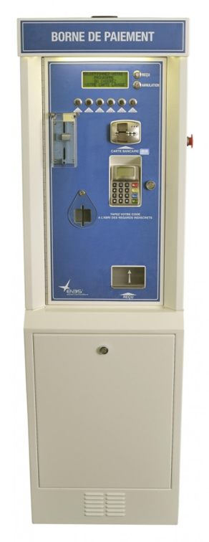

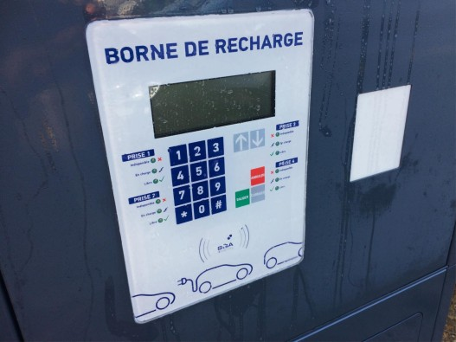
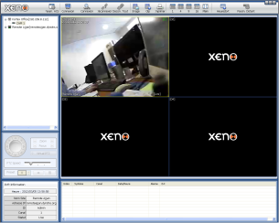
ELECTRICAL AND WASHING TERMINALS
LYRA SIM
Automatic CB reader
LM3G / LM4G
Wash terminals
Electric vehicle charging terminals

Slide 16

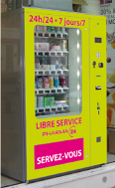


Automats and video Surveillance in 4G
Ingenico iSelf Series Compatible
IUP 250
IUR 250
LYRA SIM
LM4G

Slide 17







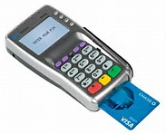





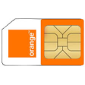



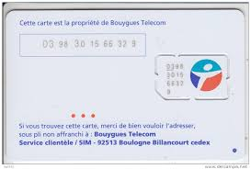


BACKUP of CENTRALIZED MONETIC SOLUTIONS
Banking
Servers
Store Router
WAN CLIENT
DC CLIENT
IP
DC SERVERS
Store
Computer room
WAN
KORTEX 3G
Router
Firewall
LAN
Cash Desk VLAN
TPE VLAN
LM3G
VPN
Banking
Servers
Cash Desk
POS
Private
Servers
ETHERNET LAN
LL
NETWORK
OPERATORS
IP
LL
LM3G
LYRA BACKUP SIM
IP / M2M ROUTAGE
X095SLM3G
Auto-configuration Through LYRA Portal
17

Slide 18
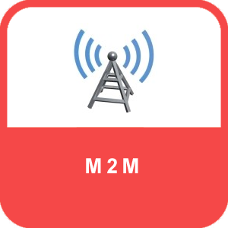
Products for ...

Slide 19






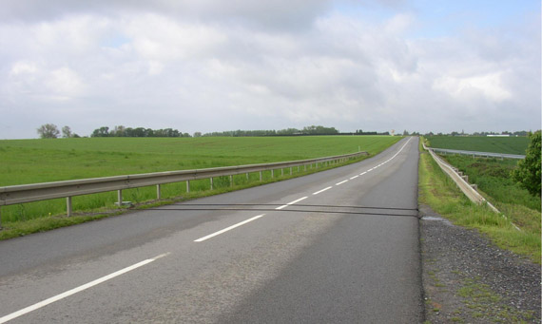


Remote management of roadside equipment
Traffic Management
NETWXORK
SIM card management and supervision
INTERNET
SERVERS
TCP / IP
Network
Mobile Operators
Public APN (Radius Server: Authentication)
Variable Message Panels
Camera
monitoring
Facilities
M2M Kortex PSI
3G
ADVANTAGES:
Real time update of the data
Cost reduction compared to the BTI
More laying of cables
3G packages with activation and simplified management of SIM cards
Simplified setup for a temporary or mobile installation.
Boucle de comptage

Slide 20

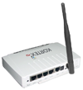

Management of town hall panels (PMV, PML)
PMV Monitoring
NETWORK
SIM card management and supervision
INTERNET
SERVERS
TCP / IP
Network
Mobile Operators
Public APN (Radius Server: Authentication)
Network
Mobile Operators
4G
ADVANTAGES:
Real time update of the data
Cost reduction compared to the BTI
More laying of cables
3G packages with activation and simplified management of SIM cards
Simplified implementation
Kx Router
4G LTE PRO
Kortex PSI M2M Equipment

Slide 21
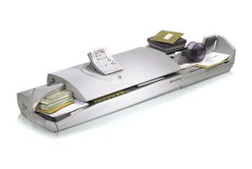


Management of franking systems: M2M
Management / IS
NETWORK
SIM card management and supervision
INTERNET
SERVERS
TCP / IP
Network
Mobile Operators
ADVANTAGES:
Public APN (Radius Server: Authentication)
Real time update of the data
Cost reduction compared to the BTI
More laying of cables (M2M)
3G packages
Simplified implementation
security
Equipment
KORTEX PSI
3G
M2M
Internet
KX ROUTER 3G PRO
Mixed marking and franking solution

Slide 22


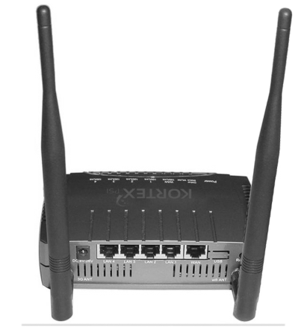



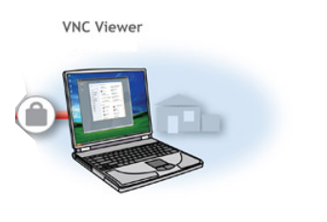

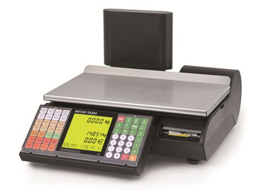
Connected Scale: 3G Transmission
M2M Flux + authentification
Network
Mobile Operators
IP
INTERNET
Option
Gestion des cartes SIM
IP
IP
Supervision
Serveurs
Privatifs
KX EASY BACKUP PRO
Dyn DNS
Server
FTP
Server
SIM LYRA
M2M
Application job
HTTP
Server
Connected scale
SMTP
Server
Socket
Server

Slide 23

Products for ...

Slide 24








Temporary connections in 4G
Banking Server
Private Server
Public X25 Network
Banking Server
X25
LL
LL
Ethernet POS
Kx Router 4G LTE Pro
IP/X25 Platform
Cash
LAN
IP PPTP, L2TP, GRE access, IPSEC VPN ...
Headquarters of a company
Business Server
PC

Slide 25

Products for ...

Slide 26






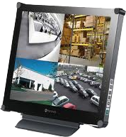
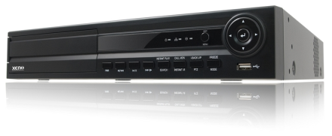





4G Router for video doubt removal system
Shops or Companies
Dyn DNS Server
* The Kx Router 4G LTE PRO integrates a Dyn DNS client which allows the link between a domain name and the associated IP address, which is updated every 24 hours on 4G networks.
INTERNET
LIVE Flux 4G
M2M SIM
INTERNET
towns
Commissions
shops
Building
Parking
Warehouses ...
Kx Router 4G LTE PRO
Video Recorder
Local
Screen
Telemonitoring application
Cameras: lifting doubt
PC Remote Monitoring

Slide 27

Products for ...

Slide 28

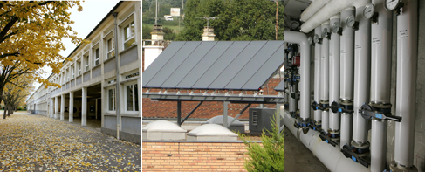





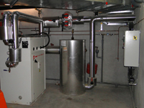



ENERGY PERFORMANCE: 3G transmission
Private APN gprsnac.com (Radius Server: Authentication)
home
M2M Flux + « Energy Channel»
+ LYR Authentification
M2M flow routing via LYRA
Banking
Server
WAN
« 3G »
Plateforme
IP/X25
X25
OPERATORS
NETWORKS
IP
LL
IP
IP
LL
Gestion des cartes SIM
Serveurs
Privatifs
Private
Server
Supervision
KX WM-Box Energy
Serveurs
Dyn DNS
LYRA
Transparent, VPN, MPLS
Boiler room
FTP
Server
LYRA M2M SIM
LYRA Portal
HTTP
Server
Management of boiler system: SNMP
HTTP
XML
SMTP (e-mail)
SMTP
Server
Socket
Server
3G streams are secured by our private APN

Slide 29



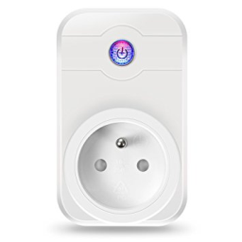




Switching on the PLC controlled by SMS
Order sent in WIFI by the router
SIM LYRA
Phone to send SMS to control the router
and Power ON/OFF the Power Outlet
220 V
LM3G / LM4G
Power Outlet controlled by Wi-Fi
AUTOMATON
POS TERMINAL
POS terminal connected to the LM3G router

Slide 30

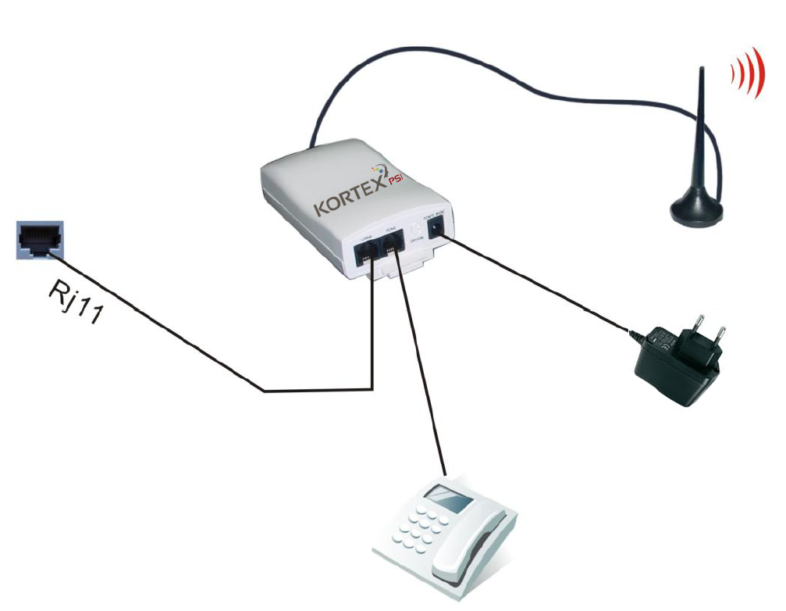
The end of the PSTN: maturity 2021, THE POTS
+ AN ALTERNATIVE SOLUTION TO SUSTAIN ITS PSTN INVESTMENTS
  Lifts
  Alarms
  Medical
  Remote meter reading
  Electronic banking
THE POTS
Ensures the migration of your equipment connected to the Switched Telephone Network (PSTN) in GSM or 3G.

Slide 31








Benefits of KORTEX Services and Products
Choice of connectors: Serial, USB, Ethernet ...
Security: SSL, VPN ...
Industrial and robust equipment
Customization by trades and projects
Complete range of accessories
Reactivity of the teams
Own R&D developing embedded software and applications
Support and dedicated technical support

Slide 32

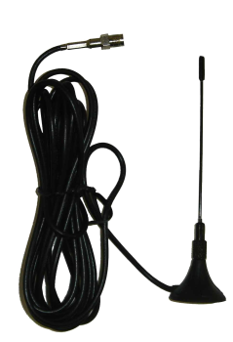

Essential accessories for 2018
Some essential accessories from KORTEX PSI
  Sector blocks
  Din-Rail Brackets for Modems and Routers
  Network adapters, series ...
  Standard and custom cables
  Indoor and outdoor antennas for automata.
Ref: CB001332
Ref: CB001331 magnetic
Supplied with mounting bracket
Ref : CB001334 à vis
Ref: CB001330
magnetic
D71x14 mm
D47x210 mm
Magnetic or nut antennas.

Slide 33






#Some References:
They use it
+ BENEFITS OF EMERGENCY WITH LM 3G / 4G
  Equip yourself with a reliable and powerful router (connected in 3G / 4G with ETH / Wi-Fi)
  Save on the cost of the equipment (cheaper than a backup GPRS TPE)
  Manage queues in the event of a network outage
  Reduce the implementation time (configuration from the Lyra portal)
  Ensure continuity of service

Slide 34


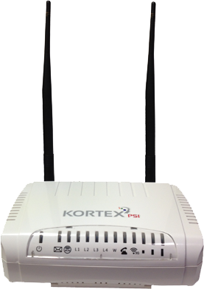


Developments to come
Identification of containers of chemical substances, drugs.
Identification of street furniture, public games, ornamental trees for maintenance and monitoring.
Exchange of business cards during events.
Body implants.
Livestock monitoring: food, lactation, weight.
Smart environment: Fire detection, flood alert, air pollution ...
Smart Energie: Measurement of gauges, temperatures, reading of water / gas / electricity meters, sensors, management of solar panels ...
Smart Cities: Parking places, street lighting, garbage, PML / PMV display ...
Security: Transmission of alarms, leak detection ...
Industries: Machine control, automatic sensor reading ...
Agriculture: Irrigation control, animal tracking, ...

Slide 35

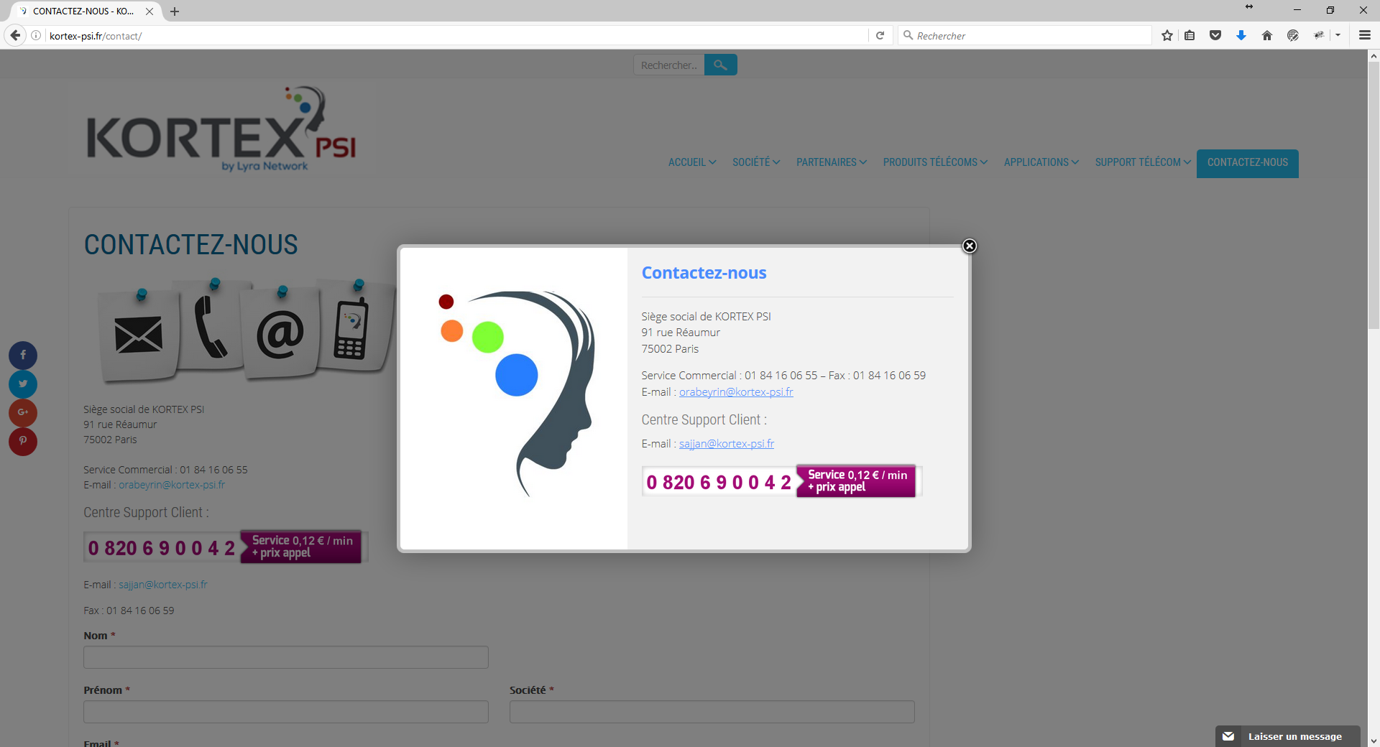
THE END
THANKS

